Slide 1

Instagram Clone Dataset Analysis using SQL :
By Abhishek Roy

Slide 2

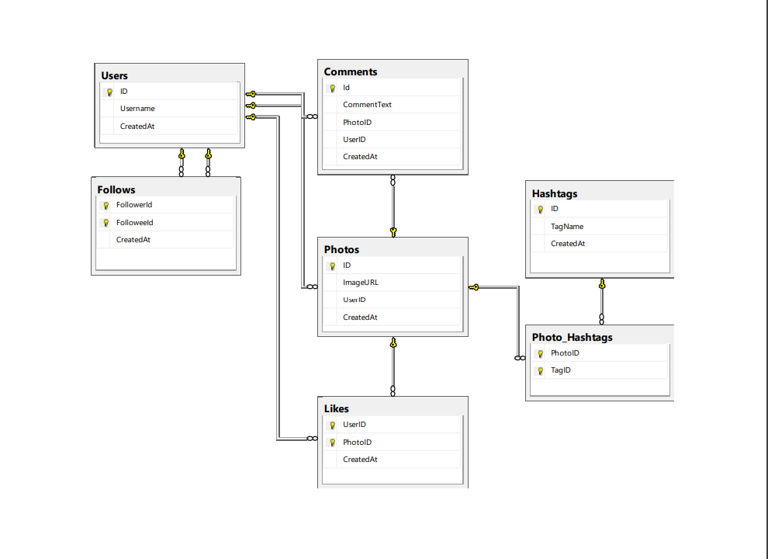
Instagram Clone Dataset Schema :

Slide 3
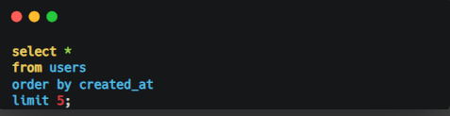
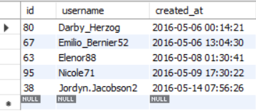
1. Find the 5 oldest users.
Output :

Slide 4
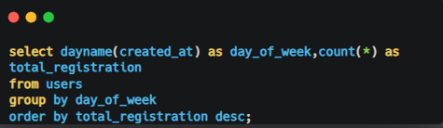
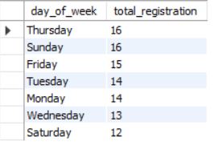
2. What day of the week do most users register on?
We need to figure out when to schedule an ad campaign
Output :

Slide 5

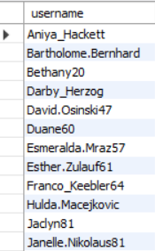
3. We want to target our inactive users with an email campaign.-- Find the users who have never posted a photo.
Output :

Slide 6
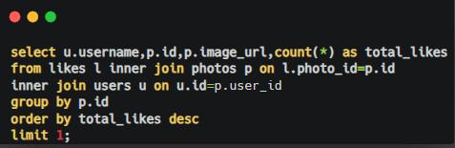

4. We are running a new contest to see who can get the most likes in a single photo?-- Who won?
Output :

Slide 7
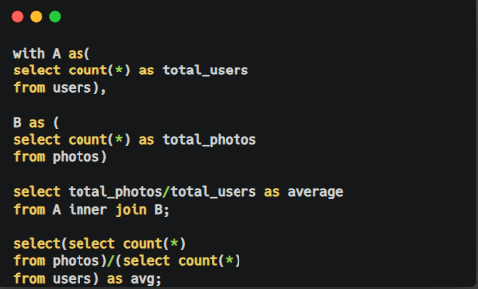

5. Our investors wants to know how many times does the average user post?
Output :

Slide 8
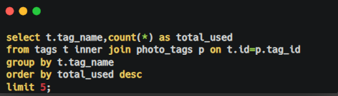
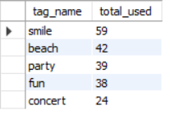
6. A brand wants to know hich hashtags to use in a post?-- What are the top 5 most commonly used hashtags?
Output :

Slide 9
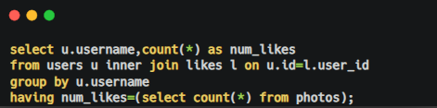
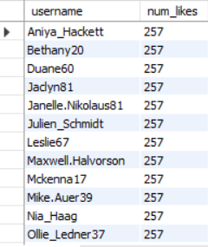
7. We have a small problem with bots on our site.
Find users who have liked every single photos on our site.
Output :

Slide 10
THANK YOU

